Slide 1
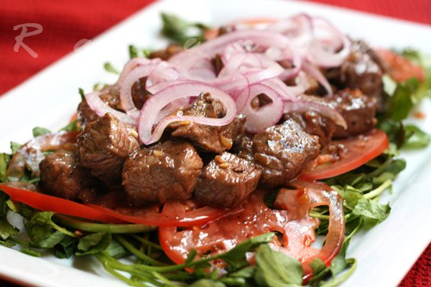
How to make: Shaking Beef (Bò Lúc Lắt)

Slide 2
Ingredients
2 lb of Beef (either sirloin, filet mignon or rib eye)
3 tbsp soy sauce
1 tsp pepper
2 tsp sugar
2 tbsp mined garlic
1 tsp salt
1 red bell pepper, 1 red onion, ½ yellow onion, lettuce
2 tbsp veg oil
2 lemons.

Slide 3
Preparation
Beef cut into 1 or 1 and half inches cubes depends on your desire.
Cut bell pepper in to 1’’ squares
Thinly sliced red onion
Peel lettuce into slices
Slice tomatoes (thin or thick as your desire)

Slide 4
Step 1
Marinate the be ef with 1 tsp minced garlic, 2 tsp sugar, 3 tbsp soy sauce, ½ tsp peppers, 1 tbsp veg oil. Mixed them up and put it a side for 1 hour, preferable 2-3 hours for a good marinated.
Mix the sliced red onion with 1tbsp sugar, squuze 2 whole lemons and set it aside.

Slide 5
Step 2
Heat a large wok or a pan over high heat until it begins to smoke. Add 1 tbsp cooking oil and fry 1tsp minced garlic until it turns yellow . Toss in the marinated beef and shaking the pan, make sure the beef go all a round, shake it for about 1 minute, do not over cook.

Slide 6
Final: Serve and Enjoy
Put the Beef onto plate lined with lettuce and slice tomato, top off some pepper power and garnish with the picked red onions. Serve with hot plain steam rice or fried rice.

